Slide 1

Cybersecurity in the maritime sector -
A behaviour change approach
Dr Konstantinos Mersinas
Information Security Group
Royal Holloway University of London
The All-Party Parliamentary Group on Cyber Security
15 November 2023

Slide 2
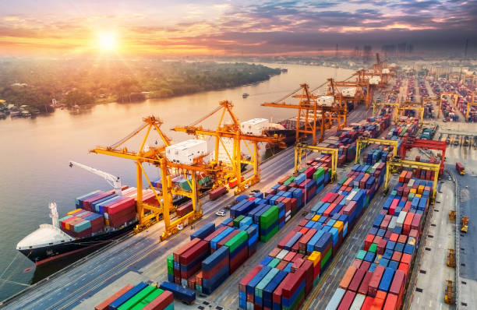
The maritime environment
- Increasing digitisation & interconnectivity
- Ship long lifecycles → legacy systems
- Heavily operational (IT & OT)
- Seafarers report: excessive workloads, lack of sleep, job-related worries
      → Decision-making, subjective risk perceptions and increased susceptibility to social engineering attacks

Slide 3
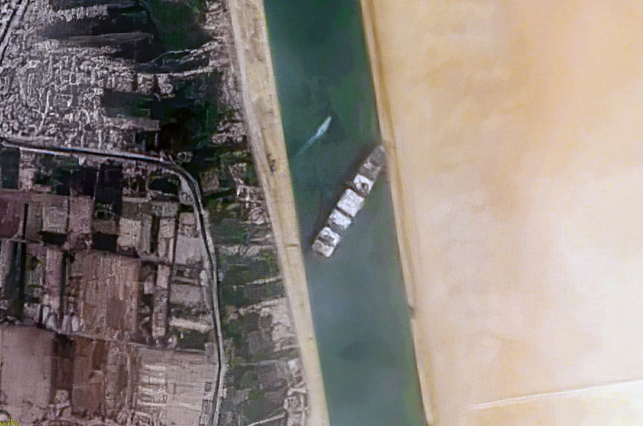
The cybersecurity environment
1. Increasing attack surfaces of Cyber Systems
- Complexity: edge, cloud, IoT → more dependencies
- Dispersion: geographical areas, on board / at port / at the enterprise centres
- Heterogeneity: old and different technologies, blurring of IT/OT boundaries
2. Cyber-attacks: become more complex and sophisticated
3. Human error: up to 90% of security breaches
4. Slow adaptation (maritime sector): architectures, practices, infrastructure
→ thus, a need for strengthening human behaviour

Slide 4
Not a new issue
‘Consideration of human element matters should aim at decreasing the possibility of human error as far as possible’, IMO

Slide 5
Humans as a target & as a means
Technical aspects → evolution of cryptography, computer security, network security, …
Attacker shift → the opportunistic nature of attackers and their adaptability has shifted attacks to the human

Slide 6

Humans - why are we susceptible to attacks?
Bounded rationality
- Cognitive limitations
- Partial access to information
- Specific time frame
→ Phishing attacks
if a specific motivation, interest or emotion is triggered, the individual might fall for the phishing attack

Slide 7
Humans
Human → error-producing mechanism ✗
Human → defensive mechanism ✓

Slide 8
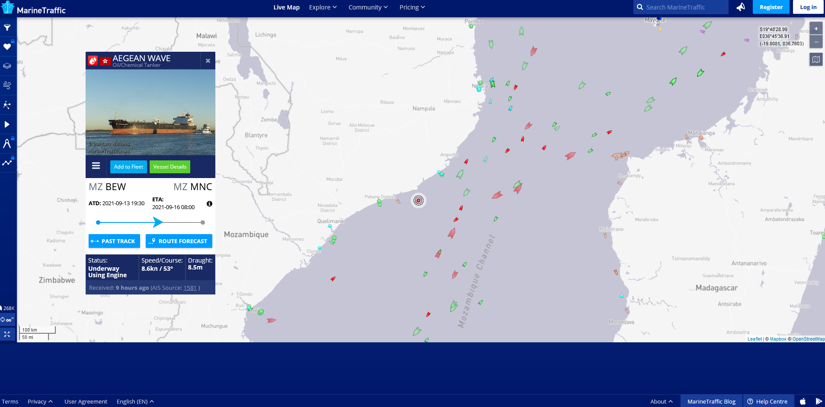
Proposed behaviour change approach: fear appeals & digital assistant
Behaviour change via:
- Individualised
- Context-dependent
- Dynamic (machine learning based)
prompts & messages to staff
Indivudual: skills, digital literacy, risk perceptions/attitudes
Context: ports, ships, enterprise centres
Algorithms: train security policies and user behaviour

Slide 9
Behavioural interventions – Behaviour change
Security awareness message to users
Appraisals
Effect on individual
Result
Perceived threat
Defensive stance
Message is rejected
No action or opposite action
Message
1. Likelihood
2. Impact
1. Likelihood
2. Impact
3. Self efficacy
4. Response efficacy
Perceived efficacy
Protection Motivation
Message is accepted
Desirable action taken; behaviour change
3. Self efficacy
4. Response efficacy
Fear

Slide 10


Thank you!
References
Mersinas, K. and Chana, C.D., 2022. “Reducing the Cyber-Attack Surface in the Maritime Sector via Individual Behaviour Change”. The Seventh International Conference on Cyber-Technologies and Cyber-Systems.
Contact
Konstantinos.Mersinas@rhul.ac.uk
linkedin.com/in/kmersinas/
Questions?

